Slide 1
Blockchain
Innovating Data and Data Security
February 19, 2019

Slide 2
Topics and Ideas
What is Blockchain?
Relevancy Today - Applications of Blockchain
Does it Mean Anything for Security?
The Nitty-Gritty Details (don’t panic)
3Blue1Brown - Security in Numbers
Realistic Expectations for Blockchain Development
Industry Opportunities
Concerns Today
Discussion

Slide 3
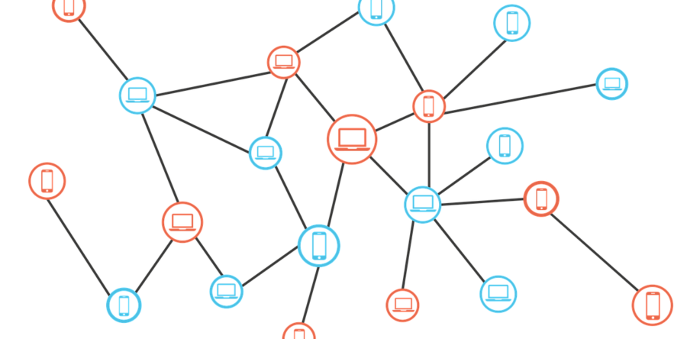
Blockchain: What isn’t it?
Not a database (similar)
Not a cloud solution
Not a physical entity
So then… what?

Slide 4
Blockchain is:
(excuse the buzzwords)
A record of transactions, stored within a decentralized network formed by a peer-to-peer architecture.

Slide 5
Breaking it down: Blockchain VS Database
Database is:
Blockchain is:
Based on a Client-Server Architecture.
Not necessarily devoted to security or transparency.
Based on a P2P Architecture.
Focused heavily on removing single-party responsibility.
Using smart contracts to form the legal backbone of the blockchain and build protocols.

Slide 6


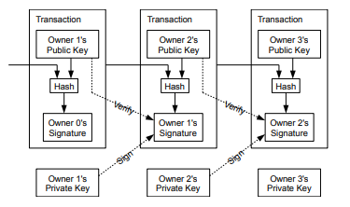
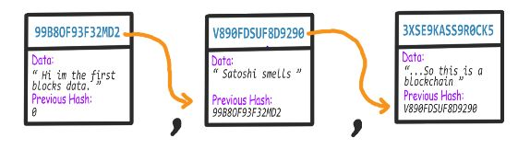
Inside the transactions

Slide 7
What good is it?

Slide 8
BLOCKCHAIN SECURITY
SHA-256:
2²⁵⁶ possible outcomes for each hash
Arguably the best current Hashing Algorithm out there
It takes the string from the block, and hashes it
This is where miners come in

Slide 9
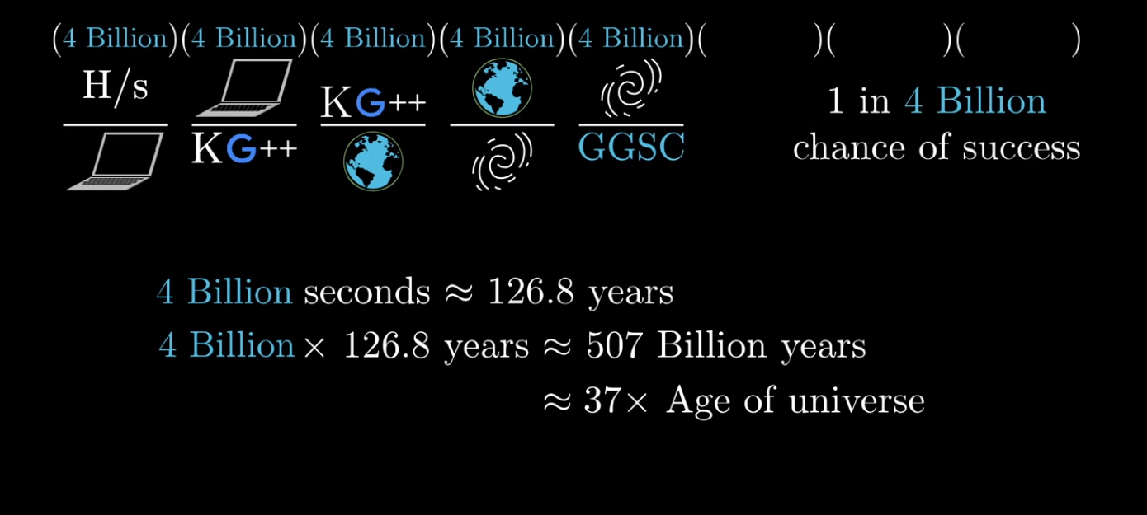
Source: 3Blue1Brown

Slide 10
Blockchain Application & dApps
Decentralized Applications are known as dApps.
Not using Blockchain:
BitTorrent, Tor, BitMessage
Using Blockchain:
Ethereum Applications:
Thousands available, from games to financial tools.
Traditional Web App:
Front End -> API -> Database
dApp with Blockchain:
Front End -> Smart Contract-> Blockchain
Backend code is running in a decentralized manner (P2P)

Slide 11
More Potential Applications:
Cryptocurrency / Finances (duh)
Insurance Claims, International Payments, Asset Management
Digital Identity
Passports/IDs, Wedding/Death/Birth Certs
The Internet of Things! (IoT Presentations)
Smart Homes
Supply Chain / Logistics
Incentivization of pre existing infrastructures

Slide 12
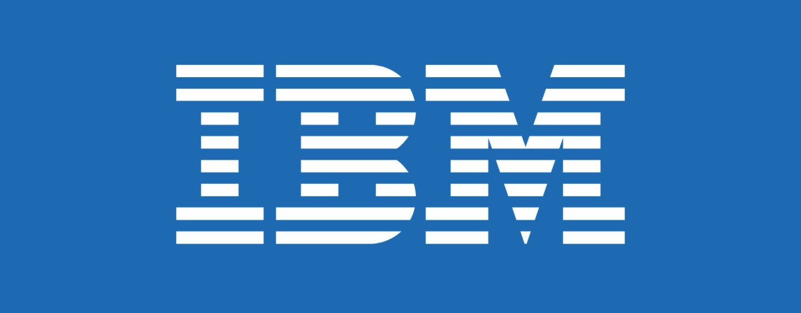
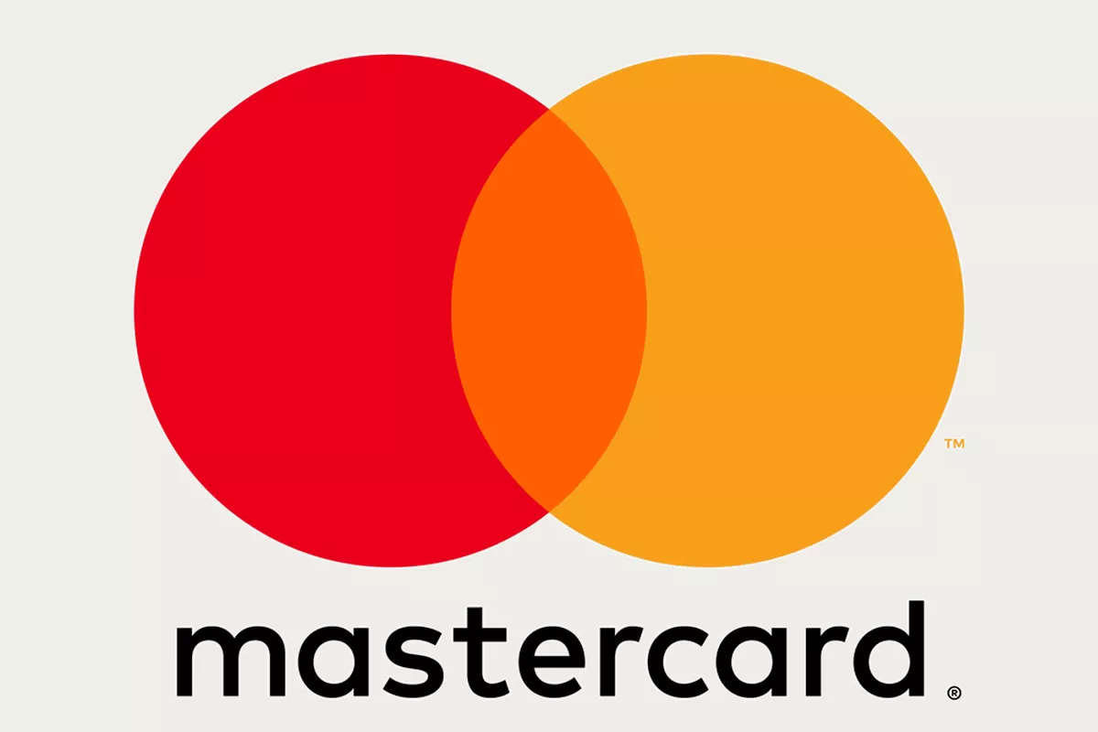
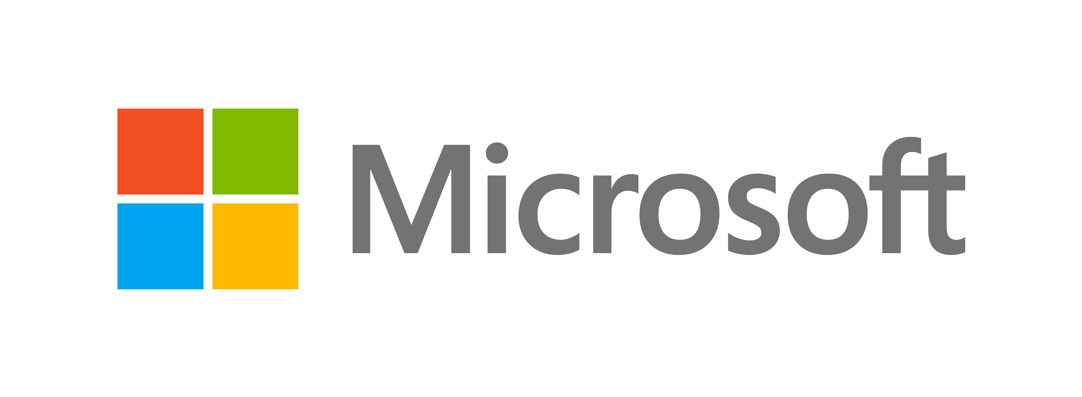
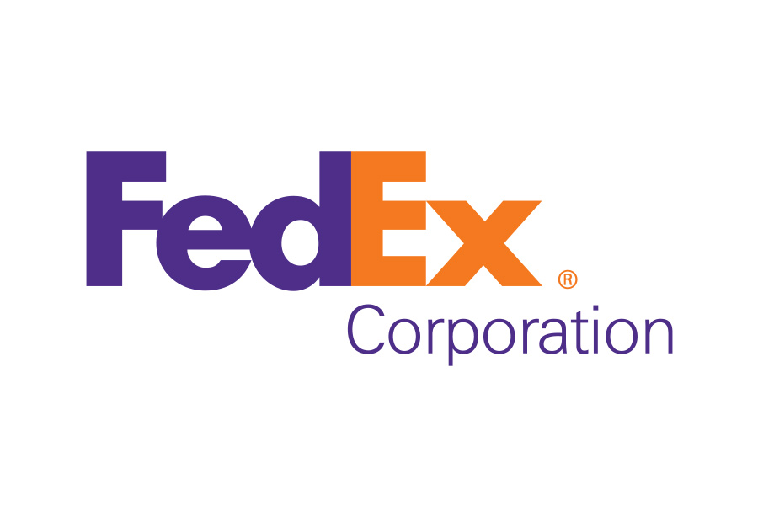
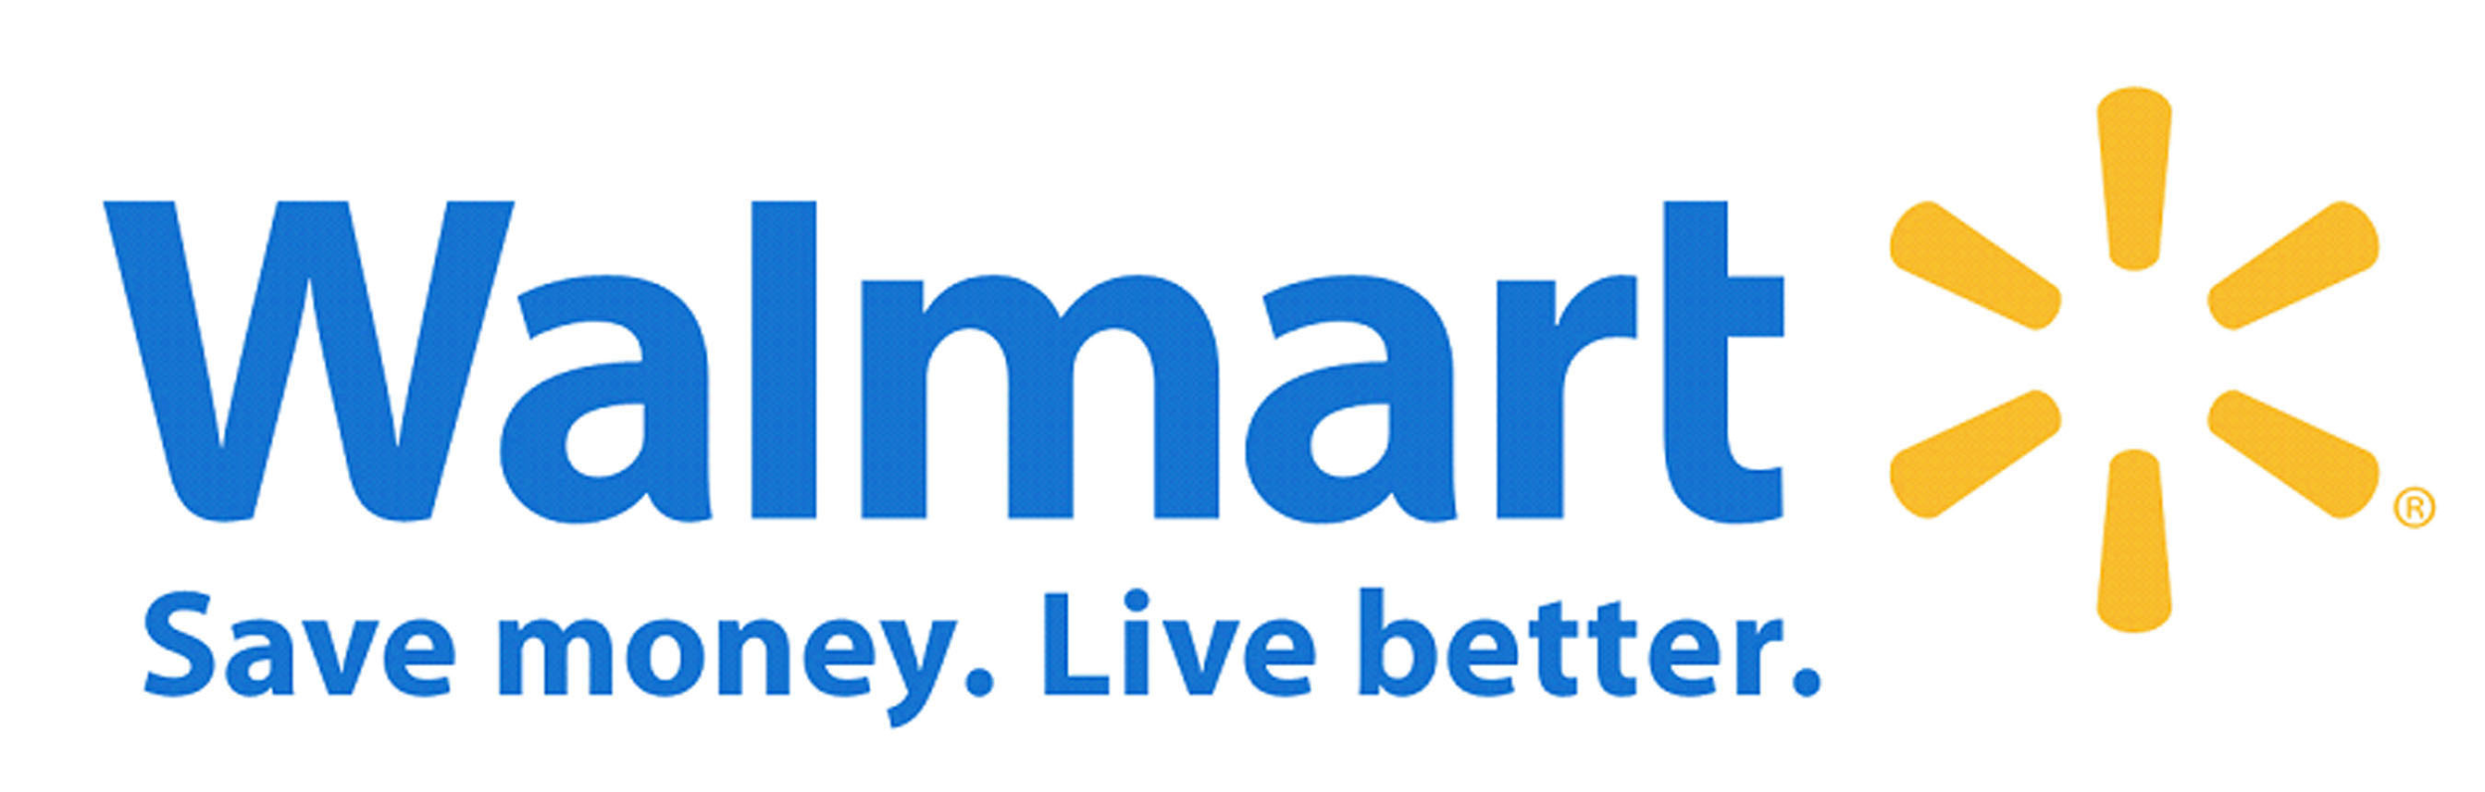
Who’s Using it Now?

Slide 13
Concerns with Rapid Industry Growth
Smart Contracts are exposed to the public. Any errors can be openly seen and exploited.
New Solidity Developers
Volatile Market
Lack of industry understanding

Slide 14
Discussion:
https://deqode.com/blog/supply-chain-finance-blockchain/
Cutting cost, time, and effort + security in supply chain ventures
https://coinswitch.co/news/ethereum-price-prediction-2019-eth-price-to-touch-1450-usd-in-2019-latest-ethereum-news-update
Ethereum 1x to be dropped soon -> major update to the Ethereum network
Blockchain Projects raising millions create domino effect across major exchanges

